Slide 1

Team Name:Crafty Tech
SR UNIVERSITY HACKATHON’22
Theme: Disaster Management
Problem Statement Title: Automatic potholes and humps identification system

Slide 2
Existing solution
SR UNIVERSITY HACKATHON’22
Features:
The existing model will detect the potholes, humps then it will intimate the driver.
It includes the pothole depth and hump height.
Limitations:
The existing models do not capture photos of potholes and humps.
Authorities do not know the location of potholes.

Slide 3
Description of idea
SR UNIVERSITY HACKATHON’22
Identifying the potholes,humps,stagnant water, laying down cables by using sensors which are connected to the municipality vehicles.
Taking pictures of them using camera.
It includes the pothole depth,hump height and water level information, along with the photo and location.
Retrieving the images and finding that specific area using GPS by the certain authorities.
Taking action by sending one team over there.

Slide 4
Uniqueness
SR UNIVERSITY HACKATHON’22
The information about the potholes and humps is known to the municipal authorities
Detects stagnant water in those potholes using water detection sensor.

Slide 5
Community use
SR UNIVERSITY HACKATHON’22
Directly useful for the municipality authorities
Indirectly useful for the people

Slide 6
Technology Stack
SR UNIVERSITY HACKATHON’22
Water detection sensor
Ultrasonic sensor
Camera

Slide 7
Solution approach
SR UNIVERSITY HACKATHON’22
Some of the accidents are caused in local areas due to the potholes and humps and stagnant water. The location of these potholes and humps are not known to the municipality authorities. So our approach for this is to we are going to attach a camera and sensors for GWMC vehicles such that they can detect the patholes and humps in tha streets and click the photos of them . These photos are viewed by municipal authorities so that they can take neccessary action in that particular location.

Slide 8
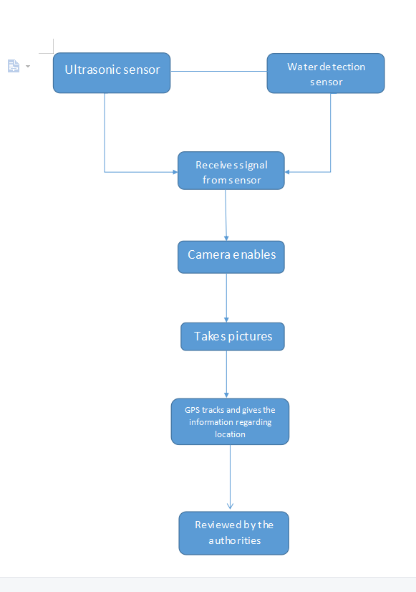
Block diagram
SR UNIVERSITY HACKATHON’22

Slide 9
Reference
SR UNIVERSITY HACKATHON’22
https://www.researchgate.net/publication/277658928_Automatic_Detection_and_Notification_of_Potholes_and_Humps_on_Roads_to_Aid_Driversa
https://towardsdatascience.com/building-a-realtime-pothole-detection-system-using-machine-learning-and-computer-vision-2e5fb2e5e746

Slide 10
Conclusion
SR UNIVERSITY HACKATHON’22
As the manual checking and working the issue is becoming delay. so to avoid that we use this sensor based identification and working in a short span which helps in faster and effective solution to solve the abnormalities on road

Slide 11

SR UNIVERSITY HACKATHON’22

